Slide 1
ANDROID Prototype
Mandeep Kaur
5 July 2024

Slide 2
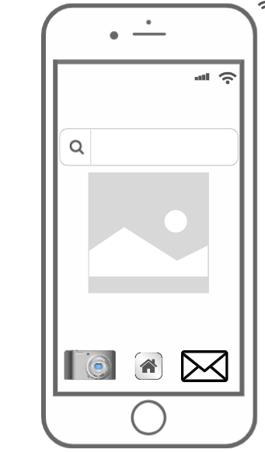
Home Page

Slide 3
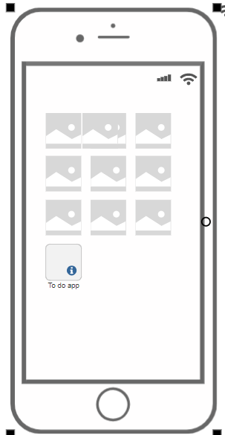
TO do List Icon

Slide 4
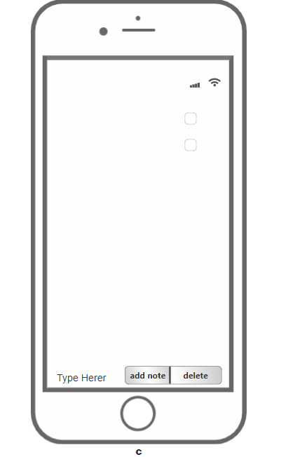
App Page

Slide 5
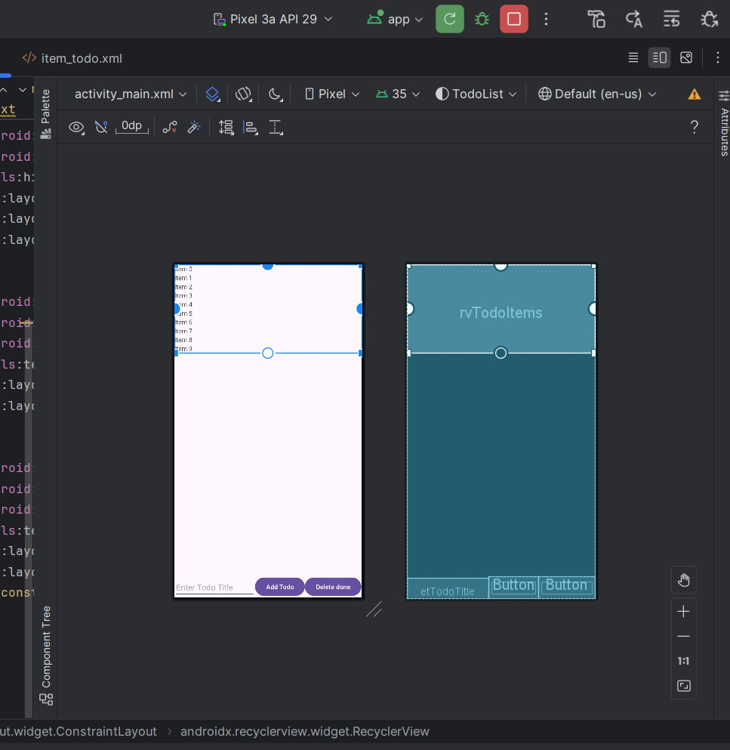
Layout

Slide 6
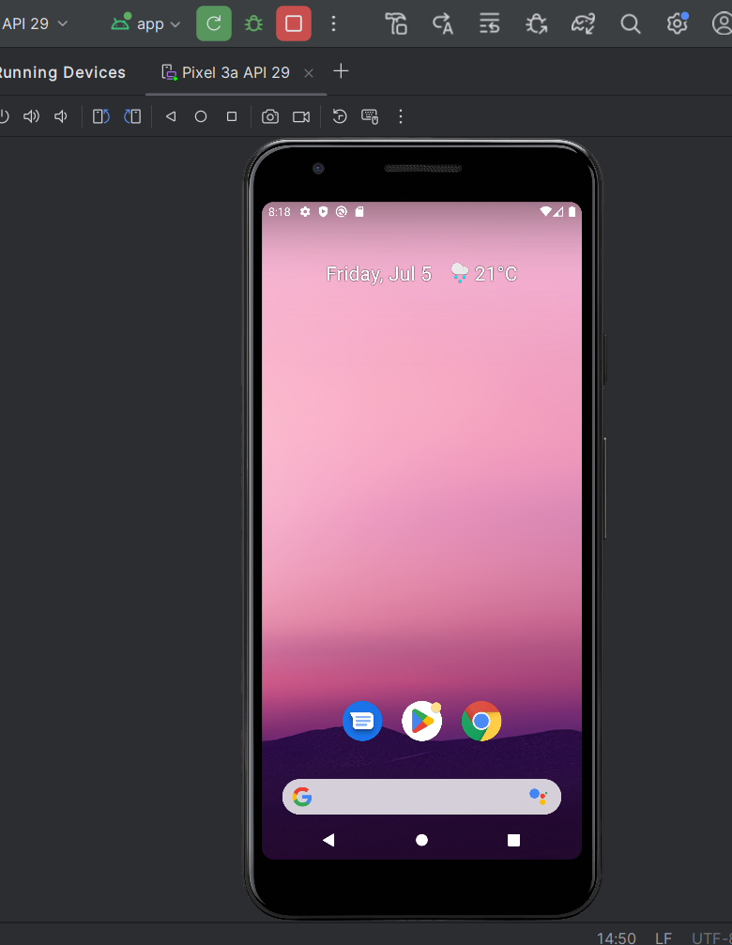
Home Page

Slide 7
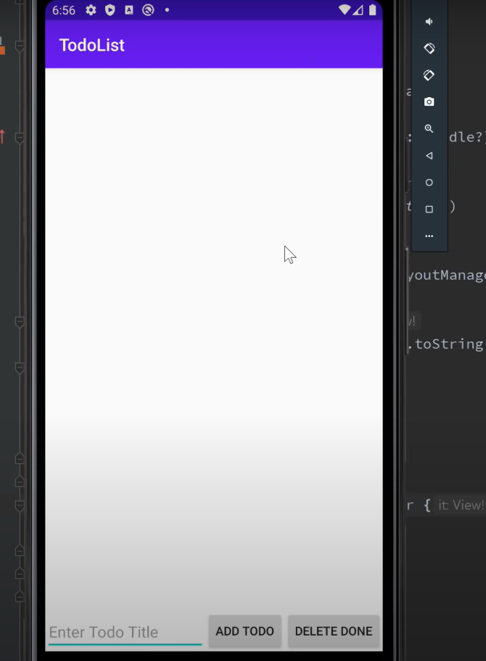
App Page

Slide 8
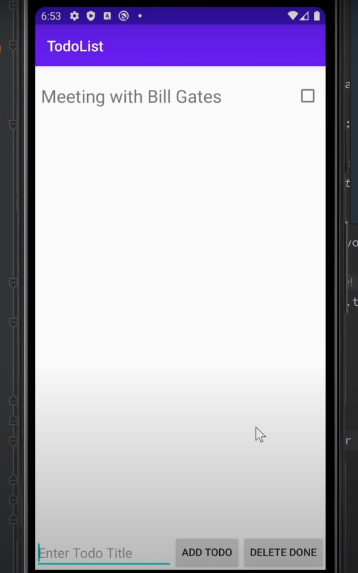
Add List

Slide 9
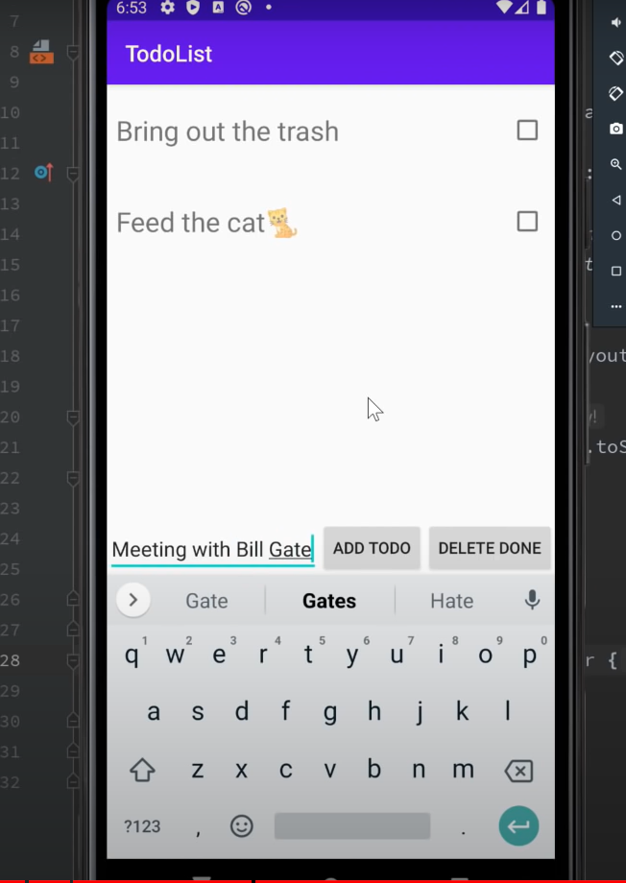
Adding the task

Slide 10
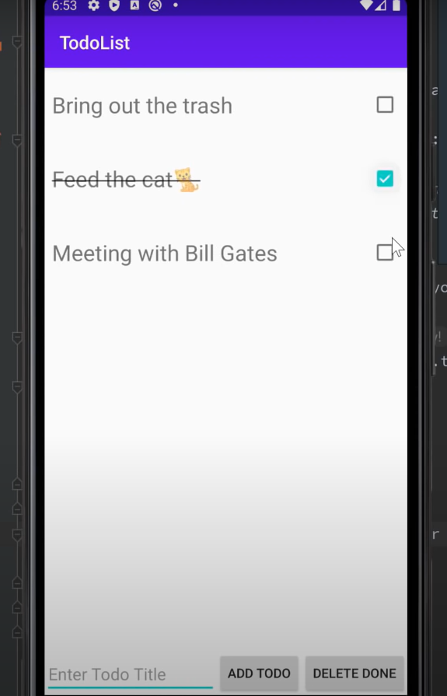
Delete the list

Slide 11
End

